Slide 1



Nursing for All: Advocacy, Equity, and Excellence in Care
KEYNOTE ADDRESS ON ANNUAL NURSES WEEK CELEBRATION
PRESENTED BY DR OMOKEHINDE OYEBODE
DIRECTOR OF NURSING SERVICE, MINISTRY OF HEALTH.
OYO STATE

Slide 2


We thank God Almighty for the opportunity to gather together for this year’s at the annual nurses week celebration! Some states can only celebrate it virtually, while others states are not even celebrating because of the current economic situation in the country.

Slide 3
Since the “JAPA” began, many state have reported a “staggering rise” in mental health issues for nurses cum Nursing students.
Nurses and Nursing students in Nigeria have shown that:
93% reported experiencing stress,
86% reported anxiety and depression
77% reported experiencing frustration
76% reported exhaustion and burnout
75% reported being totally overwhelmed
Nurses cum their students are also more significantly likely to be in the high symptom group compared to other healthcare workers
These figures are similar to those in other state as we experience in Oyo state.

Slide 4

Apart from the mental health issues, many nurses/student nurses have lost it. However, they still continue and must continue to
ADVOCATE
EXERCISE EQUITY
PROVIDE EXCELLENCE CARE
Despite the burnout you must continue to make the sacrifice in a professional way, and I hope that your association will, at every point during this event, continue to remind one another what you have signed up for which is stated above.

Slide 5
For five years now (since 2017), the overarching theme for International Nurses Day celebration has been “Nurses: A Voice to Lead” with sub-themes ranging from
“…Achieving the SDGs” in 2017,
“…Health is a human right” in 2018,
“…Health for all” in 2019,
“…Nursing the world to health” in 2020,
“…A vision for future healthcare” in 2021
All the sub-themes bring out the central position and importance of nurses in addressing a wide range of health challenges

Slide 6
The above is similar to what we will be discussing today:
Nursing for All: Advocacy, Equity, and Excellence in Care

Slide 7
The Role of Nursing in Modern Healthcare
• Overview of nursing as a profession.
• Emphasizing the global need for equity in healthcare.
• Nurses' critical role in promoting inclusivity and quality care.

Slide 8
Why the focus on “Advocacy, Equity, and Excellence in Care” (Why is it important for nurses/students nurses to advocate)
Nurses/student nurses have the potential to be influential agents of change and innovation since they stay 24/7 with the patient
They have a very powerful and legitimate voice that they can use to influence the health systems of the future
Nurses/student nurses are insightful, creative and passionate about patient care, and other social issues

Slide 9
Why the focus on “Advocacy, Equity, and Excellence in Care” (Why is it important for nurses/students nurses to advocate)
Nurses and nurses students are with patients and their families during some of the most vulnerable moments in life, so they have a unique opportunity to use their voice to make advocate.

Slide 10



As patients’ advocates, nurses have a voice that can impact change for nursing practice and ultimately improve patient care
Nurses use their voice to share best practices which enhance patient outcomes, nursing quality, practice standards, policies and procedure
Being an advocate this implies focusing on the need for nurses to become more active and vocal in policy development and implementation

Slide 11

As an advocate: nurses/Nursing is:
Capable of influencing and impacting positive change, because nurses have insightful perspectives on issues
Urgently needed at all levels from the bedside to the Boardroom; from policy formulation to healthcare decision-making
However, Nursing has not always had the loudest voice in the healthcare system
If anything, this voice has consistently been muffled by others

Slide 12


Based on the importance of the Nursing advocacy, nurse leaders need to create an open environment where nurses’ and student nurses voice is not only listened to, but heard, and acted upon to help drive the health agenda

Slide 13

Nurses as Advocates for Patients
Advocacy: Ensuring patient rights and well-being.
• Examples:
- Supporting underserved populations.
- Promoting public health initiatives.
• Nurses as champions of healthcare reform.

Slide 14
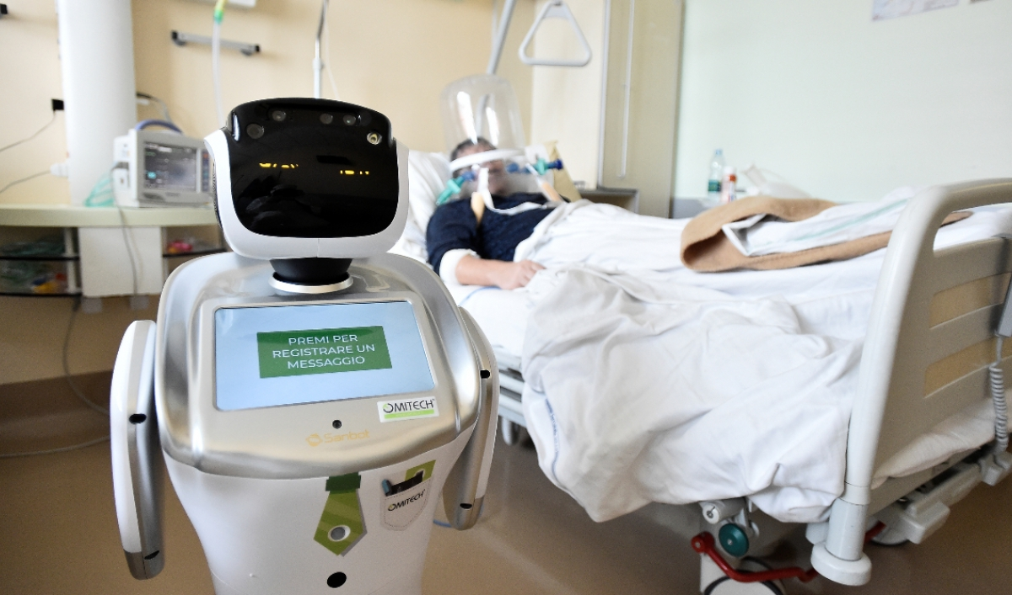
Addressing Disparities in Care
• Importance of equitable care delivery.
• Examples:
- Providing resources to rural communities.
- Culturally competent care for diverse populations.
• Bridging gaps in access to care.

Slide 15

Striving for Excellence
• Attributes of excellence:
- Compassion, competence, and evidence-based practice.
• Strategies for professional growth:
- Continuous education and training.
• Commitment to high-quality care.

Slide 16

Real-world Examples of Advocacy and Equity
• Case Study 1: A nurse addressing health disparities in a rural area.
• Case Study 2: Successful advocacy for improved maternal health outcomes.
• Highlighting the impact of dedicated nursing efforts.

Slide 17

Overcoming Barriers
• Challenges:
- Limited resources, cultural differences, systemic biases.
• Solutions:
- Policy reform, education, and collaboration.
• Empowering nurses to lead change.

Slide 18

Building a Better Future Together
• How can nurses lead the change?
• Advocate for underserved communities.
• Commit to lifelong learning and innovation.
• Collaborate for sustainable healthcare solutions.

Slide 19
The Role of Nurses in Nigeria in a vision for future healthcare
Nurses, in fact, have the biggest role to play in the future healthcare landscape
They will continue to be health system navigators and enablers
Nurses of the future must embrace and integrate high-tech care
They must practice to the full extent/scope of their education and training, and take an active part in shaping the future of healthcare

Slide 20
Conclusion
Nurses are at the heart of healthcare and can no longer take a back seat in planning for a better future of the health system
They must therefore become inspired innovators and implementers of tech-driven, patient-centred and value-driven healthcare
Take part in the revolution of making healthcare more responsive to changes
There is no doubt that nursing students in Nigeria are poised to assume roles to advance health, improve care, and increase value in the healthcare of the future
However, this requires a sea-change (immense, notable, and profound transformation with substantial change in perspective), a new mind set, and new improved ways of practice

Slide 21

Summary and Inspiration
• Key takeaways:
- Advocacy, equity, and excellence transform lives.
• Closing thought: 'Equity in nursing creates healthier communities globally.'

Slide 22


Whatsoever things are good, useful, valuable, feasible, and evidence-based, let us think of them and embrace them
The time to start is NOW

